Slide 1
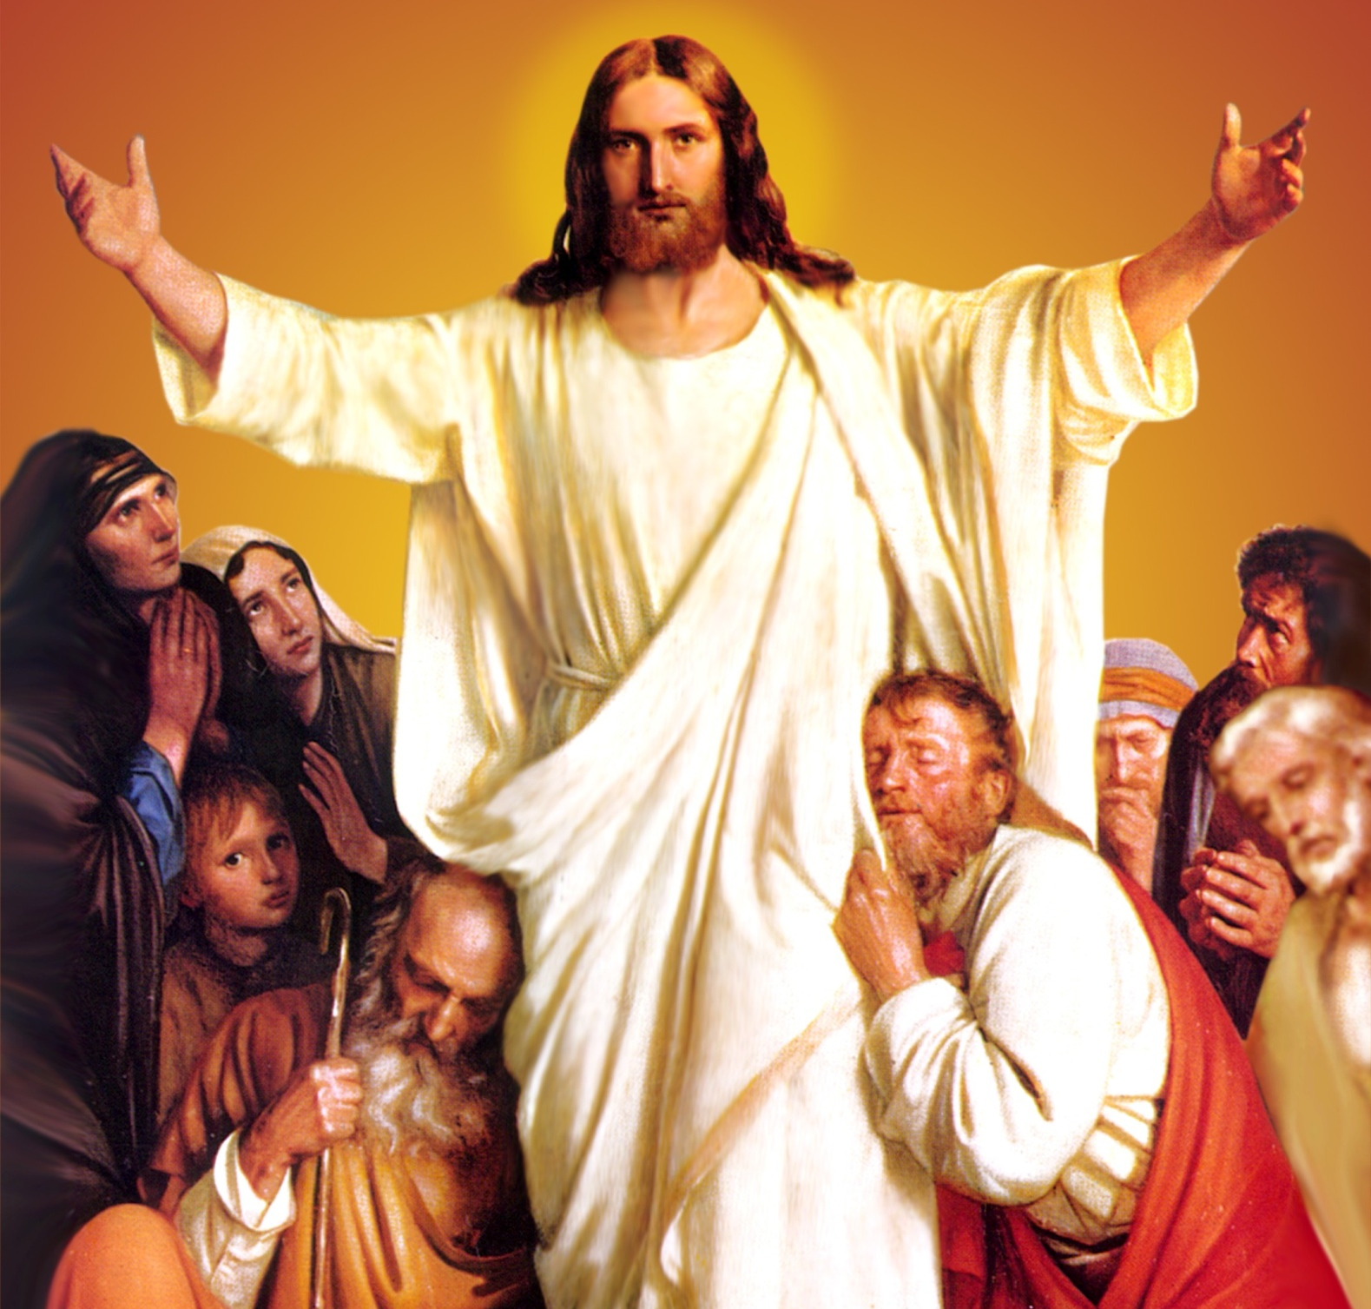
CATECHETICAL TEXTBOOK SERIES OF THE SYRO - MALABAR CHURCH
ON THE PATH OF SALVATION - 6
PEOPLE WHO
EXPERIENCED JESUS
6

Slide 2
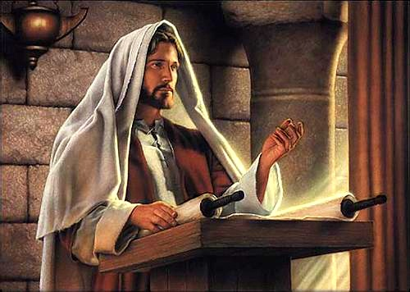
LESSON 4
JESUS WHO PROCLAIMS THE GOOD NEWS OF THE KINGDOM OF GOD

Slide 3
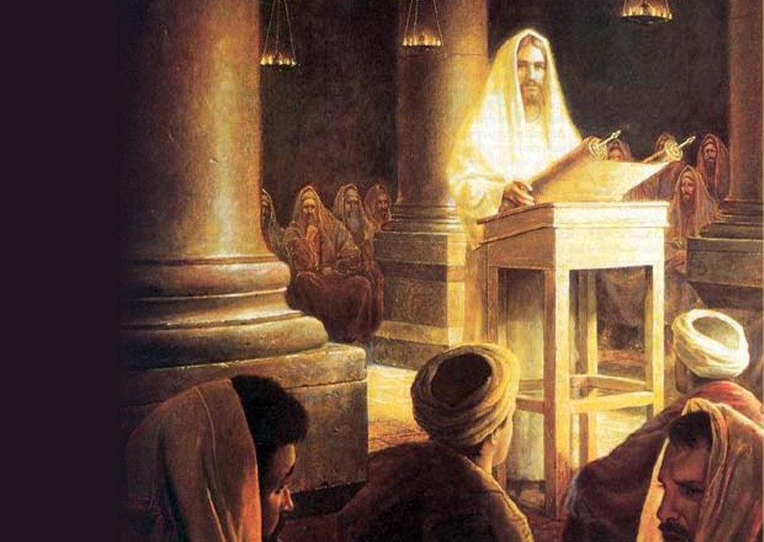
“The Spirit of the Lord is upon me, because he has anointed me to bring good news to the poor. He has sent me to proclaim release to the captives and recovery of sight to the blind, to let the oppressed go free, to proclaim the year of the Lord's favour.”
“Today this scripture has been fulfilled in your hearing.” (Lk. 4: 16- 22)
From this verse we learn that Jesus is the total liberator of mankind. Jesus, filled with the Spirit of the Lord and anointed by it, worked for our total liberation. This mission of Jesus had five important aspects.

Slide 4
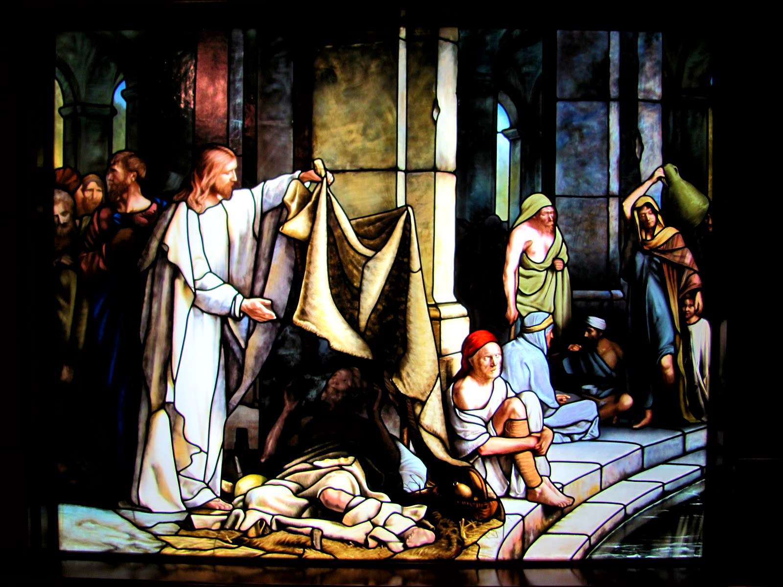
1. Good News to the Poor

Slide 5
The first and foremost responsibility of Jesus was to proclaim the good news to the poor. His first lesson was: “Blessed are the poor in spirit, for theirs is the kingdom of God” (Mt. 5: 3).
His birth, life, death and resurrection were all good news to the poor. The truly poor include not only those who suffer from economic poverty but also those who suffer from physical and mental hardships as well as the downtrodden. God is their sole refuge.
Those who depend completely on the mercy and providence of God, without depending on wealth or other material means, are the ones referred to as 'poor in spirit'.

Slide 6
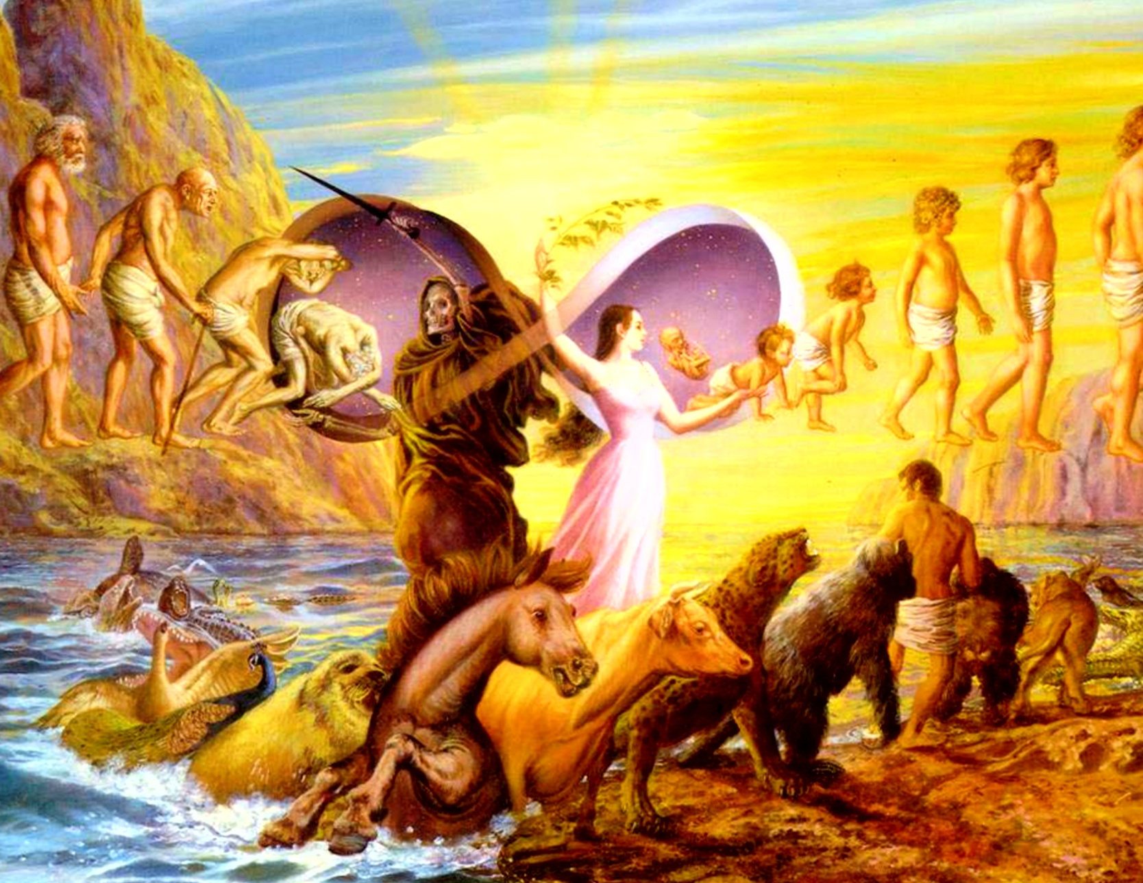
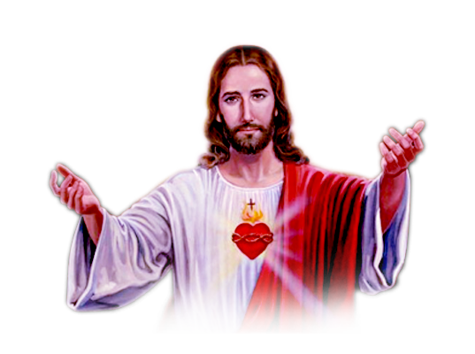
2. LIBERATION OF THOSE IN BONDAGE

Slide 7
Jesus came to redeem us from the slavery of Satan and the bondage of sin. Jesus liberates us also from social evils such as exploitation, treachery and falsehood as well as physical ailments. This truth was revealed when Jesus healed the paralytic. What Jesus said to the paralytic was:
“Your sins are forgiven” (Mk. 2: 5). Only God has the authority to forgive sins. The scribes who did not realise that Jesus was the Son of God thought that these words of Jesus amounted to blasphemy. Jeasus understood this:
“So that you may know that the Son of Man has authority on earth to forgive sins” he said to the paralytic “I say to you, stand up, take your mat and go to your home.” And he stood up, immediately took his mat and went out before all of them (Mk. 2: 10- 12).

Slide 8
On another occasion Jesus reached Capernaum, a town in Galilee. In the Synagogue of the place there was a man possessed of unclean spirit, and he cried out with a loud voice, “Let us alone! What have you to do with us, Jesus of Nazareth? Have you come to destroy us? I know who you are, the Holy One of God.” But Jesus rebuked him saying,
“Be silent and come out of him!” When the demon had thrown him down before them, he came out of him without having done him any harm. They were all amazed and kept saying to one another, “What kind of utterance is this? For, with authority and power he commands the unclean spirits, and out they come” (Lk. 4: 31- 36).
Thus we see in the gospels that Jesus gives freedom, not only from the bonds of sin and illnesses, but also from different kinds of demonic ties.

Slide 9
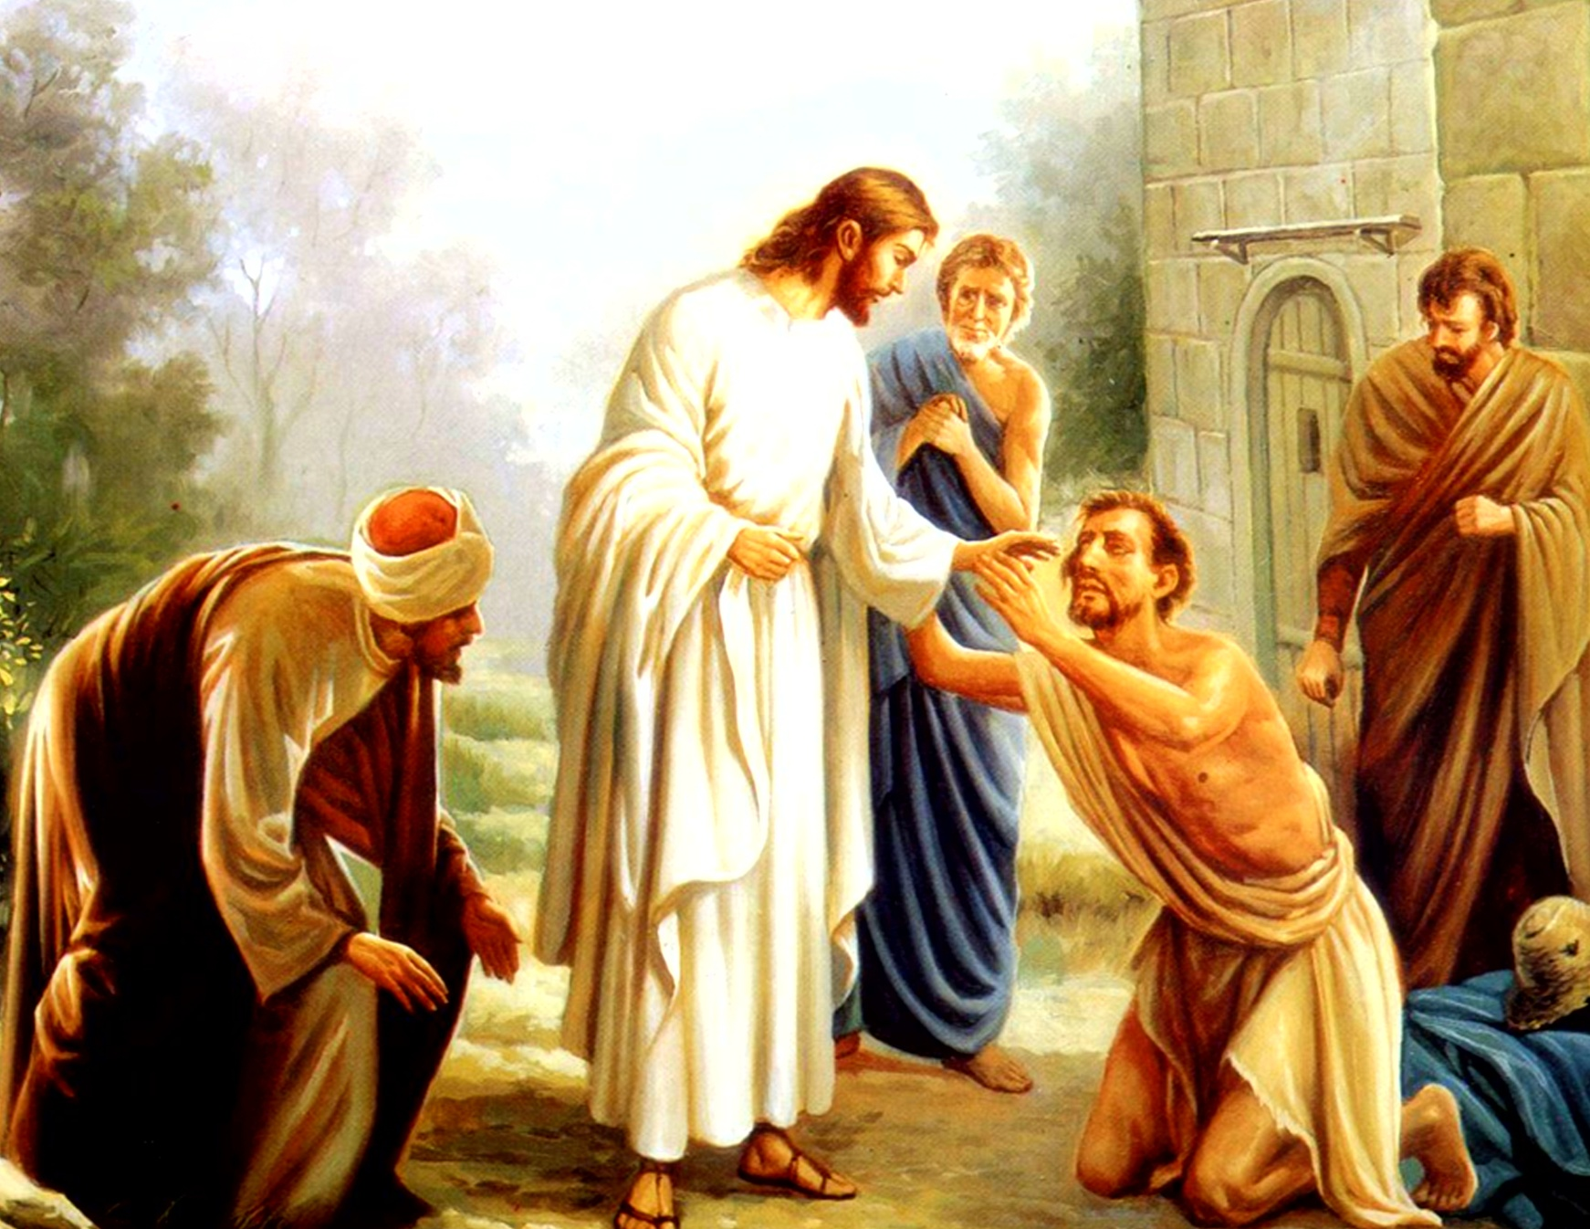
3. Sight for the Blind

Slide 10
Jesus healed many who where blind. Once, a group of blind men approached Jesus shouting: "Jesus Son of God, have mercy on us''. Jesus healed all of them. On another occasion while he was walking along with his disciples, Jesus saw a man blind from birth.
His disciples asked him, “Rabbi, who sinned, this man or his parents, that he was born blind?” Jesus answered, Neither this man nor his parents sinned; he was born blind so that God's works might be revealed in him.
Then he spat on the ground and made mud with the saliva and put it on the man's eyes, saying to him, “Go, wash in the Pool of Siloam”. Then the man went and washed and came back able to see (Jn. 9: 1- 8).

Slide 11
Learning that the Pharisees and the elders had expelled the blind man he had healed from the synagogue, Jesus said, “I came into the world for judgment so those who do not see may see, and those who see may become blind” (John 3: 39).
Realizing that Jesus had said these things about them, the Pharisees asked, “Surely we are not blind, are we?” Jesus said to them, “If you were blind, you would not have sin. But now that you say, 'we see', your sin remains” (John 9: 40- 41). What Jesus refers to here is spiritual blindness.
Jesus healed not only physical blindness. By his words of wisdom, he removed the ignorance that is spiritual blindness. He raised his voice against those suffering from moral blindness such as injustice, exploitation and falsehood, and tried to bring them to the light by the Word of truth. Those who cooperated came to the joy of salvation, praising the Lord of light.

Slide 12
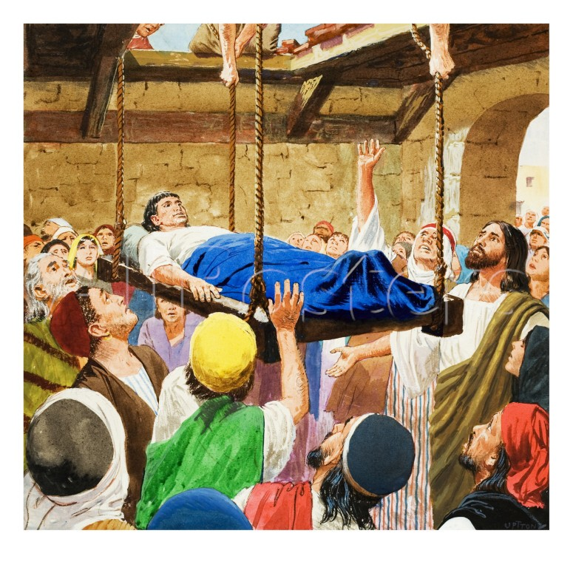
4. Freedom for the Oppressed

Slide 13
Jesus came to break and remove the chains that bind us as slaves of sin. The woman who sinned was freed from the fetters of sin. Jesus sent her away saying, “Do not sin any more”. When Jesus said to the paralytic, “Your sins are forgiven”, the man was liberated from the slavery of sin and ailment, and he took his mat and walked away.
God gave us laws to guide us walk along straight paths. But when it was misinterpreted and confined merely to external observations and rituals, the law became an instrument of oppression. Jesus criticized the Pharisees and scribes for doing so. By healing a sick person on the Sabbath, Jesus taught that the Sabbath is for man and not the other way around.
Jesus came to lead us to freedom as children of God after releasing us from the bondages of sin, sickness and the law. Every one who came to Jesus was led by him, from spiritual, mental and physical slavery to an experience of freedom.

Slide 14
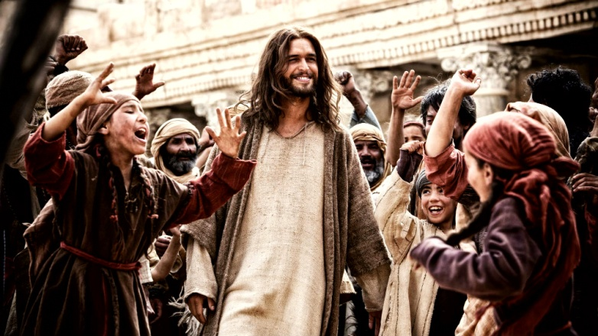
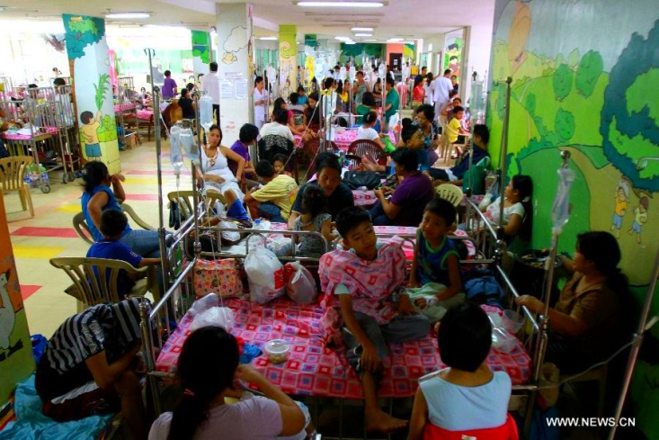
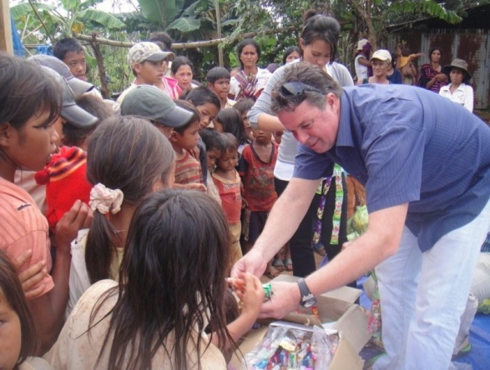
5. The Year Acceptable to the Lord
Jesus declared the year acceptable to the Lord. The year acceptable to the Lord is one where debts are written off, mercy is shown to widows and orphans, the yoke of injustice and inequality is broken, there is no hatred or vengeance and everything is shared with the poor.
One of the missions of Jesus was the building of a society where the virtues of equality, fraternity and brotherly love grow and flourish. By announcing the gospel of the Kingdom of God he taught us how this can be accomplished.

Slide 15
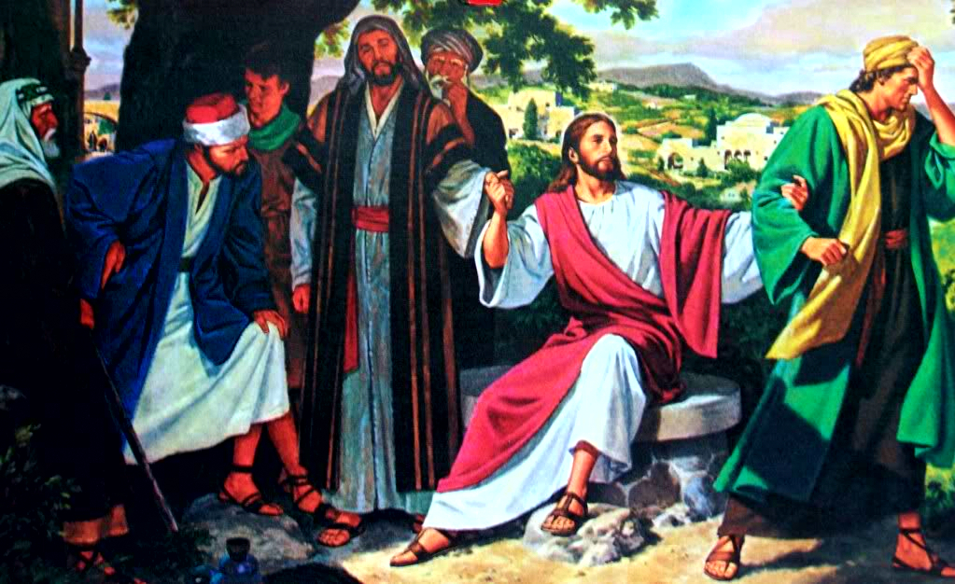
Jesus Who Announces the Kingdom of God
Jesus begins his public life with the proclamation, “The kingdom of God is at hand, repent and believe in the good news” (Mark 1: 14- 15). He announced this gospel (good news) on the hill tops, by the roadsides and in the fields.

Slide 16
Jesus gave proof of the kingdom of God through several miracles such as the feeding of a multitude with a few loaves of bread and the healing of the sick and the possessed. Through his word and his presence, this kingdom of God was made manifest to the people.
St. Paul teaches that the kingdom of God is not food and drink but justice, peace and joy in the Holy Spirit (Rom.14: 17). In the Lord's Prayer we always pray, “Thy Kingdom come”. The Kingdom of God is a condition wherein we live in a state of universal love, considering God as the Father and all humanity as brothers and sisters and as such sharing what we have. It is a community of people who live fulfilling the will of God.
The mission of the Church is to establish this state of affairs on earth. Acting as the yeast, the Church strives to spread the Kingdom of God on earth, through its presence, prayer and works. These efforts bear fruit through us, the children of God.-

Slide 17
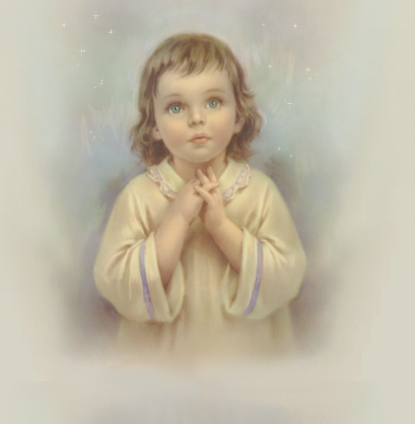
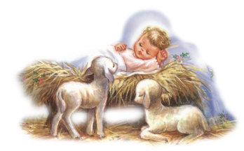
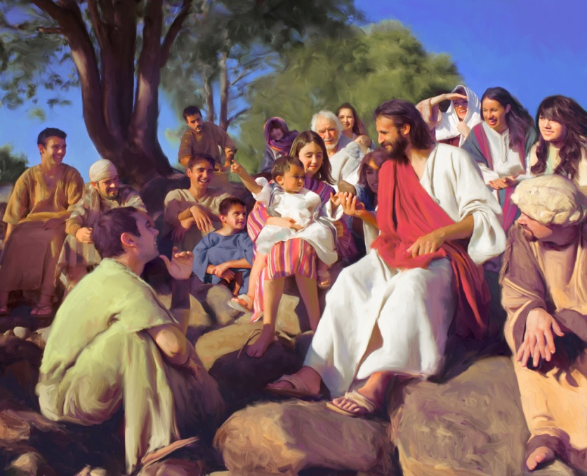
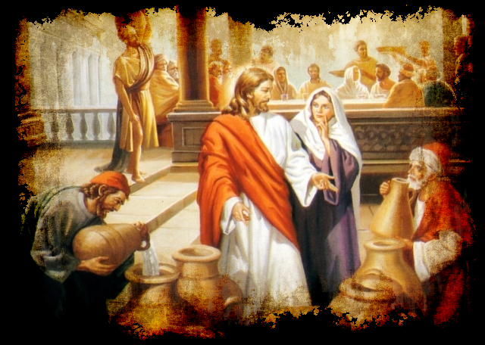
The Gospels
The disciples of Jesus recorded with the help of divine inspiration, the things he taught, the works or signs he performed, and the facts collected about his birth, childhood and public life. The Gospels are Holy Scriptures thus written. We have four gospels, named after their authors, Mathew, Mark, Luke and John. These are the first four books of the New Testament. When we read these gospels contemplatively, the greatness of the Kingdom of God announced by Jesus becomes clear to us.

Slide 18
Let us pray
O! Jesus, who preached the Gospel to the poor, help us to be your
witnesses by leading a life according to your Gospel.

Slide 19
Read the word of god:
John 1:9-34

Slide 20
WORD OF GOD FOR GUIDANCE
"Not everyone who says to me 'Lord, Lord' will enter the Kingdom of Heaven but only the one who does the will of my
Father in Heaven"(Mt.7:21).

Slide 21
LET US DO:
Present a skit in the class based on the
the healing of a blind man by Jesus.

Slide 22
MY DECISION
I will recite repeatedly the prayer:
Jesus, son of David, have mercy on me a sinner!

Slide 23
LET US Find out the answer
1. Which was the book given to Jesus for reading as he entered the Synagogue?
2. What was the mission entrusted to Jesus according to the Word of God read at the Synagogue?
3. How did Jesus remove blindness from the different dimension of human life?
4. What does 'the year of the Lord mean'?
5. How was the Kingdom of God revealed in the words, deeds and presence of Jesus?
6. What is the Kingdom of God?

Slide 24
Thank you

